Slide 1
Multi-Fund Invoice and Fund Accounting
One $30,000 invoice, charged to three funds
City of Springfield · Government ERP product exercise · Brian Ference
Notes:
I built a working prototype that takes Springfield's $30,000 invoice across three funds, end to end, including the exceptions a real AP team hits. About two minutes of context, eight minutes in the prototype, then decisions and what I would validate next.

Slide 2
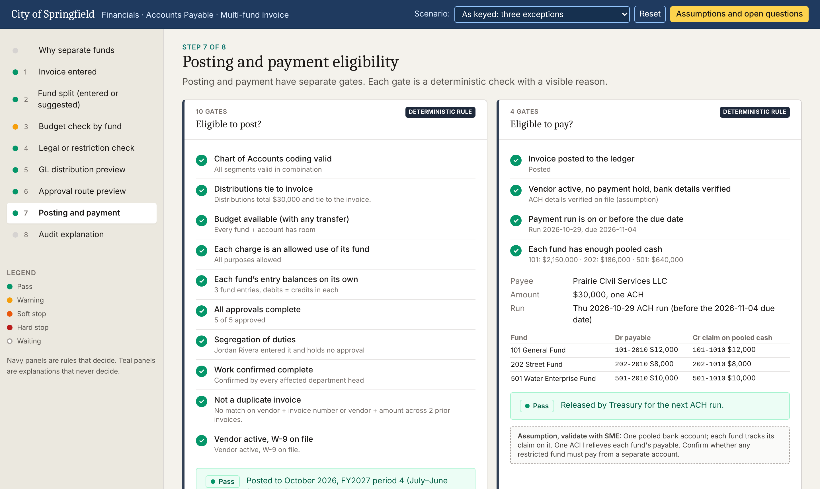
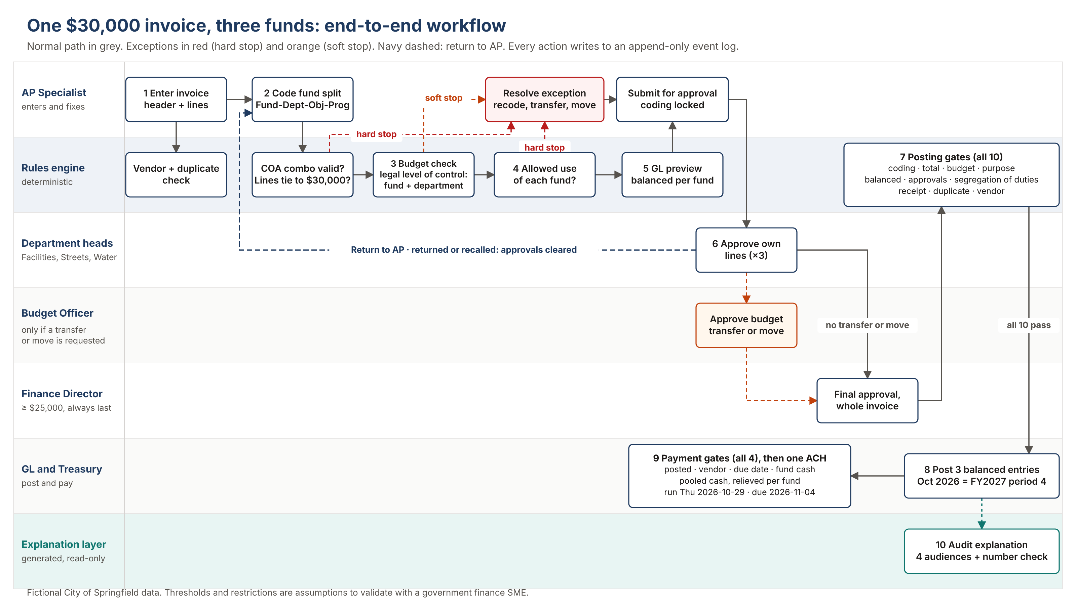
What I built
WHAT I BUILT
1
A working prototype
It runs the suggested 8-step demo flow on fictional Springfield data, after a short "Why separate funds" primer. Three starting points: as keyed with three exceptions, coded correctly, or not yet coded.
1 Invoice entered
2 Fund split (entered or suggested)
3 Budget check by fund
4 Legal or restriction check
5 GL distribution preview
6 Approval route preview
7 Posting and payment
8 Audit explanation
Two diagrams. A swimlane workflow with the exception paths (right), and the data model behind the rules.
2
This deck. Assumptions, decisions, and what a finance SME needs to confirm.
3
Notes:
Three things: a prototype that runs the eight steps the exercise suggested, two diagrams, and this deck. The prototype has a scenario switch: as keyed with exceptions, coded correctly, or not yet coded so the system suggests the split, and an Assumptions and open questions panel lists every assumption for SME review.

Slide 3
The business problem
BUSINESS PROBLEM
1
AP specialist
$30,000
one vendor invoice
Codes one bill across funds, departments, objects and programs, and has to get it right the first time.
3
funds, each a separate, self-balancing set of books
2
Department heads
Approve charges to their budget, but rarely know the fund rules or why a line was blocked.
5
approvals: 3 department heads, Budget Officer, Finance Director
3
Finance and auditors
1
payment from pooled cash
Must prove restricted money paid only for allowed purposes, with evidence for every step.
Commercial AP sees one payable. The city sees three fund entries, each with its own legal limits. The job: let a clerk split, check and route one invoice so every approver and auditor can see why each dollar was allowed.
Notes:
One vendor bill can hit money with different legal strings attached. The user pains I list here are hypotheses: rework on miscoding, managers who cannot explain a block, audit findings on restricted funds. I would confirm them with municipal users before building.

Slide 4
Fund accounting primer
REQUIRED 1 · FUND ACCOUNTING EXPLANATION
GENERAL · GOVERNMENTAL
SPECIAL REVENUE · GOVERNMENTAL
ENTERPRISE · PROPRIETARY
101 General Fund
202 Street Fund
501 Water Enterprise Fund
Money from: Taxes and fees, unrestricted
Can pay for: Facilities and street maintenance
Basis: Modified accrual
Money from: State motor fuel tax
Can pay for: Streets only
Basis: Modified accrual
Money from: Water rates
Can pay for: The water system only
Basis: Full accrual
Why separate funds
Fund vs department
No borrowing by recoding
Modified vs full accrual
Much city money arrives with legal limits. Each fund is a self-balancing set of books that proves its money paid only for its purpose.
A fund is whose money and for what. A department is who spent it. They cross: Street Maintenance spends from 101 and 202.
One fund cannot pay for another fund's purpose. Money moves between funds only by a formal transfer (assumed here to need council approval).
Governmental: revenue when measurable and available, expenditures when the liability is incurred. Enterprise: full accrual, expenses, capitalize and depreciate.
Sources: GASB Codification Sec. 1300 via NY OSC guide ch. XVI.3.B and XVI.3.D; GASB 54 fund definitions via NC Treasurer memo. Fund revenue sources are scenario assumptions.
Notes:
Four required points. Separate funds exist so restricted money is provably spent on its purpose. A fund is whose money; a department is who spent it. Money cannot move between funds by recoding, only by a formal transfer (assumed here to need council approval). Governmental funds use modified accrual; the water enterprise fund uses full accrual like a business.

Slide 5
Key assumptions
KEY ASSUMPTIONS
Data
All names, codes, budgets and people are fictional.
Invoice type
Non-PO invoice under a master services contract, so there is no encumbrance to liquidate.
Budget control
The legal level of budgetary control is fund plus department. Object is administrative.
Fiscal year
FY2027 runs July to June. Oct 2026 is period 4.
Street Fund
Funded by state motor fuel tax, restricted to street purposes.
Water Fund
Revenue restricted to the water system by rate ordinance and bond covenants.
Cash
Pooled cash. Each fund tracks its own equity in the pool.
Thresholds
Capitalization at $25,000. Finance Director approval at $25,000 and up.
All are in the prototype's Assumptions and open questions panel, for a government finance SME to confirm (slide 14).
Notes:
These are the assumptions that change behavior. The two that matter most: budget is legally controlled at fund plus department, which is why a transfer between objects inside the Street department is administrative; and the invoice is non-PO, so the budget check happens at entry.

Slide 6
End-to-end workflow
END-TO-END WORKFLOW
Notes:
The whole flow on one page. Grey is the normal path. Red loops are hard stops back to the clerk. Orange is the soft stop: over budget, resolved by a transfer that adds the Budget Officer. A returned invoice goes back to AP with approvals cleared. The explanation layer only reads the record. Now the prototype. [Live demo, about eight minutes, steps 1 to 8.]

Slide 7
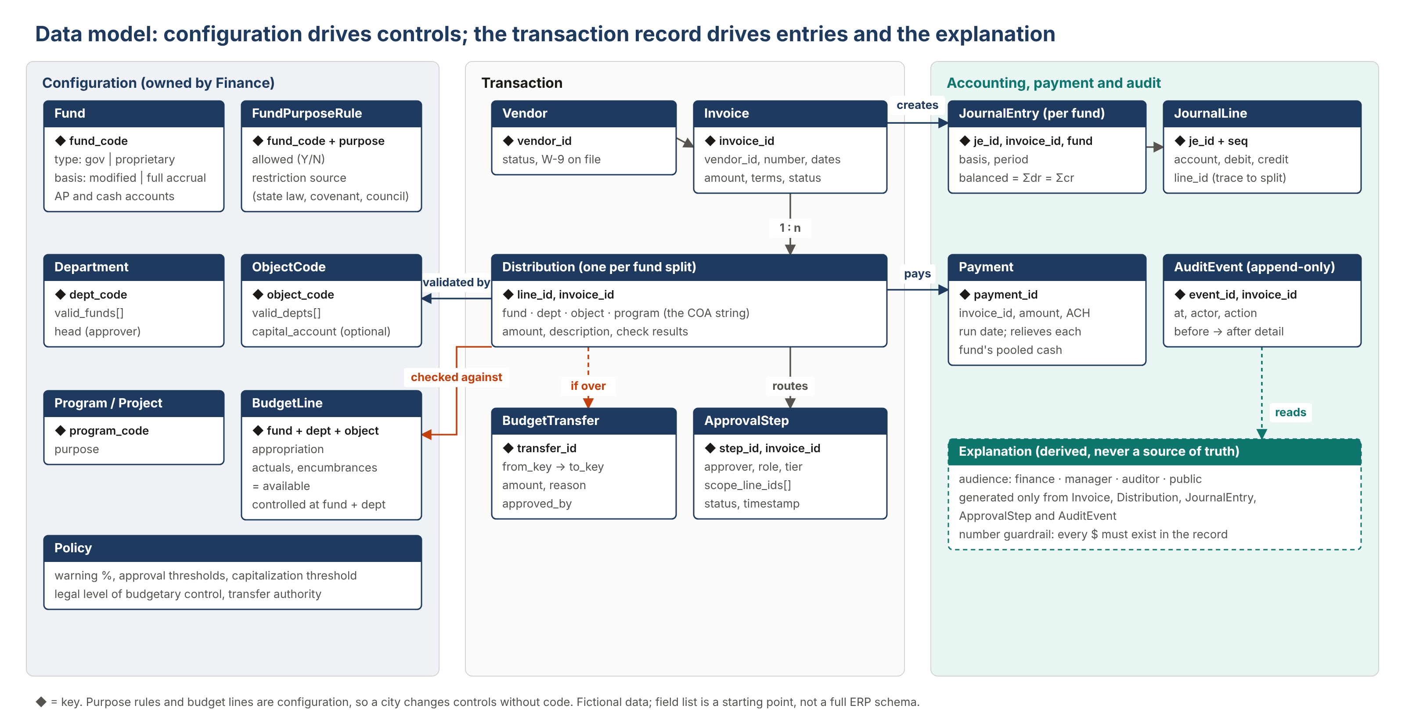
Data model and rules
DATA MODEL AND BUSINESS RULES
COA string. Every line carries Fund-Dept-Object-Program.
Dept to fund. Each department lists the funds it may spend from.
Object to dept. Each object is valid only for listed departments.
Purpose matrix. Each program purpose is allowed or not per fund.
Budget line. Available = appropriation minus actuals minus encumbrances.
Policy. Approval and warning thresholds are configuration, not code.
In production, Finance would change a restriction or a threshold in configuration, without a release. The explanation is derived and never a source of truth.
Notes:
Configuration on the left is owned by Finance: funds, purpose rules, department and object validity, budget lines and policy. The transaction in the middle produces entries, payment and the event log. The explanation reads the record and is never a source of truth.

Slide 8
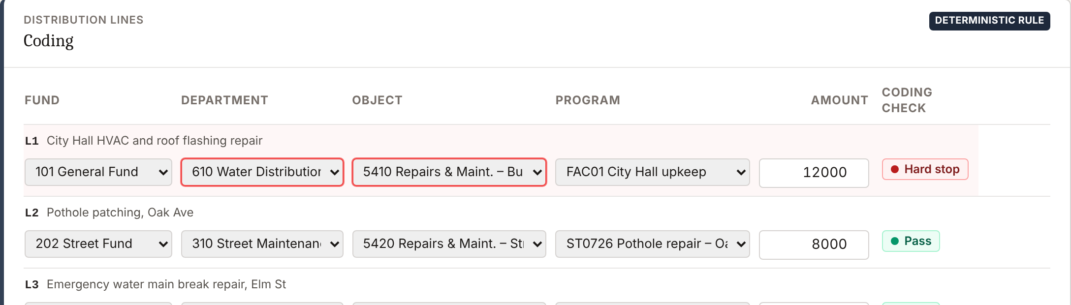
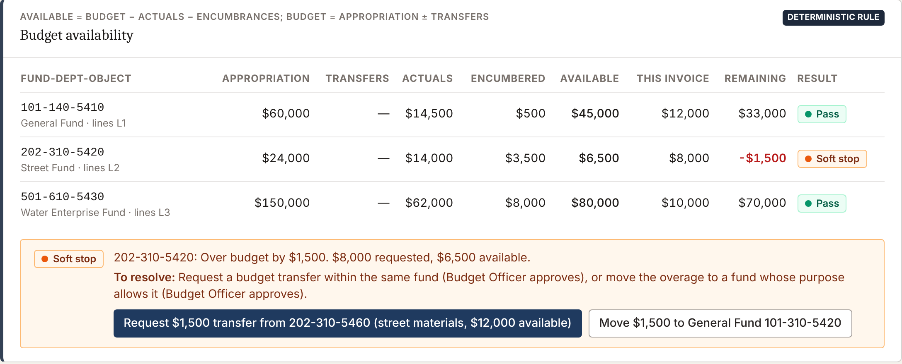
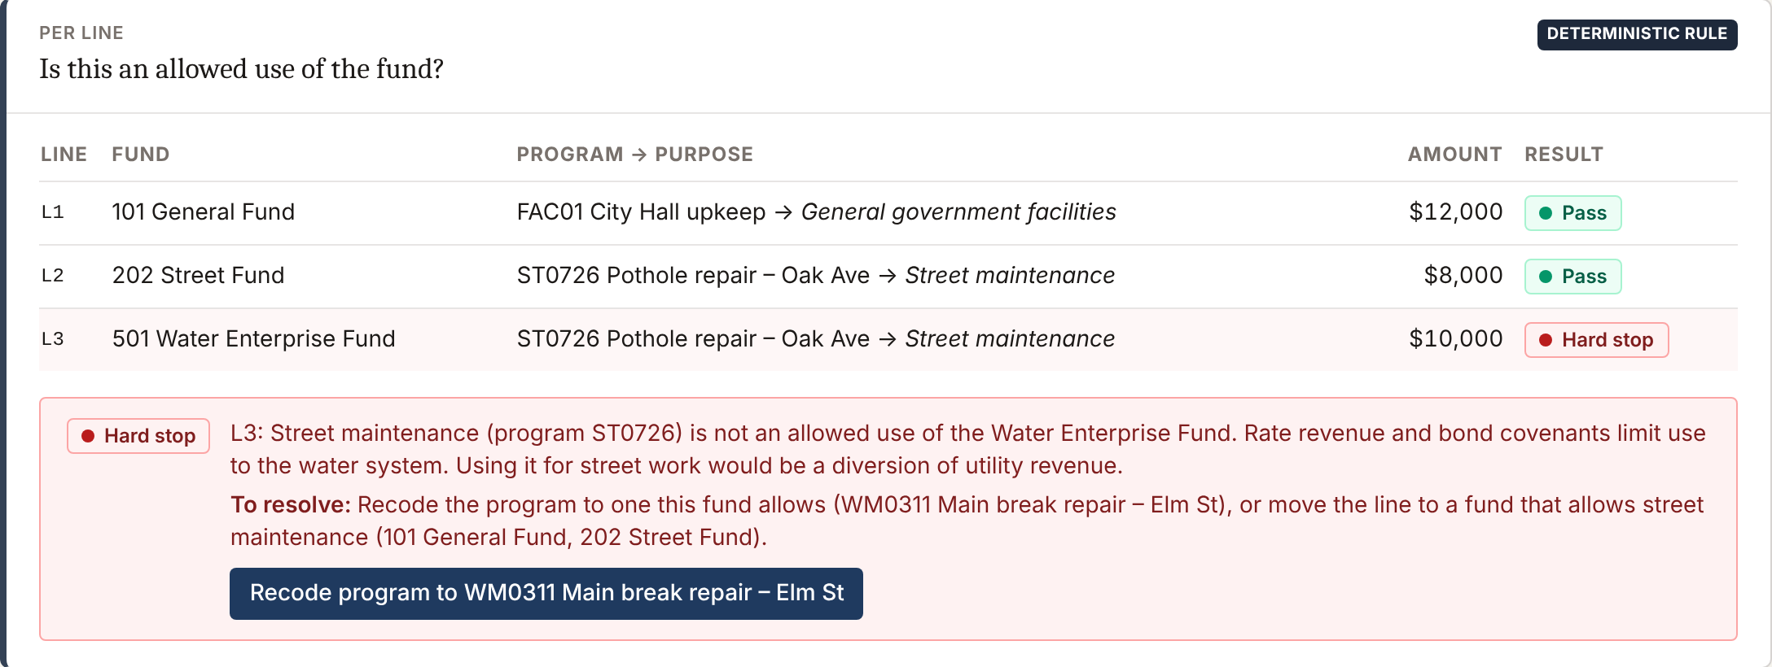
Controls and exceptions
REQUIRED 2 AND 3 · CODING, BUDGET AND PURPOSE CONTROLS
As keyed | Check | Stop | Why that level | Required resolution
L1 101-610-5410: Dept 610 Water is not valid for the General Fund | COA combination | Hard stop | Invalid structure. Nobody can approve it. | Recode to Dept 140 Facilities, one click.
L2 202-310-5420: $8,000 against $6,500 available, $1,500 over | Budget by fund and account | Soft stop | Budget has an authorized fix. | Transfer from 202-310-5460 with Budget Officer approval, or move $1,500 to 101-310-5420.
L3 Water Fund charged to pothole program ST0726 | Allowed use of fund | Hard stop | Restriction is law. It cannot be approved away. | Recode to water main program WM0311, or move to a fund that allows streets.
Every message says what is wrong, why, and the valid choices.
Notes:
Three planted exceptions on the as-keyed path, each a different control. Structure errors and legal restrictions are hard stops. Budget is a soft stop because the city has an authorized way to fix it. The clerk sees the valid choices in place.

Slide 9
Approvals, posting, payment, audit
REQUIRED 4 AND 5 · APPROVALS, POSTING, PAYMENT AND AUDIT
Approval route
10 posting gates
4 payment gates
Audit explanation
Department heads approve their own lines: Ortiz, Lee, Shah.
Budget Officer Becker joins only when a transfer or move was requested.
Finance Director Grant approves last at $25,000 and up.
5 approvals here; 4 when no budget fix is needed.
Rivera (AP) keyed it and can never approve it.
Submit locks coding. Return or recall clears approvals.
1. Coding
2. Total ties to $30,000
3. Budget
4. Purpose
5. Balanced per fund
6. Approvals
7. Segregation of duties
8. Receipt confirmed
9. Duplicate
10. Vendor
In production the posted record is read-only and corrections use a reversing entry.
1. Posted
2. Vendor active
3. Due date: Thu 2026-10-29 run, before the 2026-11-04 due date
4. Fund cash available
One ACH for $30,000. Each fund relieves its own payable.
For four audiences: finance, department manager, auditor, public.
Generated from the transaction record and event log.
Guardrail withholds text that names an amount, fund or person not in the record.
Department heads see only their own lines, the budget left after, and why they are on the route; the Finance Director sees all lines.
Notes:
The route is generated from the transaction: three department heads, the Budget Officer only because a transfer was requested, and the Finance Director last because the invoice is $25,000 or more. The person who keyed it can never approve. Ten gates decide posting and four decide payment, each with a visible reason. After posting, the record is read-only.

Slide 10
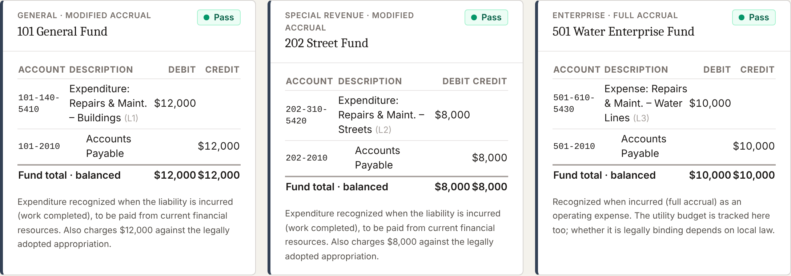
Accounting entries
REQUIRED 4 · GL DISTRIBUTION AND POSTING PREVIEW
On posting, one balanced entry per fund
Governmental vs enterprise
Fund | Basis | Debit | Credit | Amount
101 General | Modified | Expenditure 101-140-5410 | Accounts Payable 101-2010 | $12,000
202 Street | Modified | Expenditure 202-310-5420 | Accounts Payable 202-2010 | $8,000
501 Water | Full accrual | Expense 501-610-5430 | Accounts Payable 501-2010 | $10,000
Expenditure vs expense. 101 and 202 record expenditures. 501 records an expense, like a business.
Capital. At $25,000 and up, 501 would capitalize and depreciate. A governmental fund records a capital outlay expenditure.
Appropriation. In production the budget effect would post to the budgetary ledger only, not to these GL entries.
On payment, each fund pays from its share of pooled cash
Fund | Basis | Debit | Credit | Amount
101 General | Modified | Accounts Payable 101-2010 | Equity in Pooled Cash 101-1010 | $12,000
202 Street | Modified | Accounts Payable 202-2010 | Equity in Pooled Cash 202-1010 | $8,000
501 Water | Full accrual | Accounts Payable 501-2010 | Equity in Pooled Cash 501-1010 | $10,000
Debits equal credits inside each fund, not just in total. Entries shown after the approved L2 budget transfer.
Sources: NY OSC ch. XVI.3.D (expenditures vs expenses); Wisconsin Accounting Manual 16-03 (capital outlay vs capitalize).
Notes:
One invoice creates one balanced entry per fund. The governmental funds record expenditures, the water fund records an expense. Payment is one ACH, and each fund relieves its own payable against its equity in pooled cash. In production the appropriation effect would live in the budgetary ledger, not these entries.

Slide 11
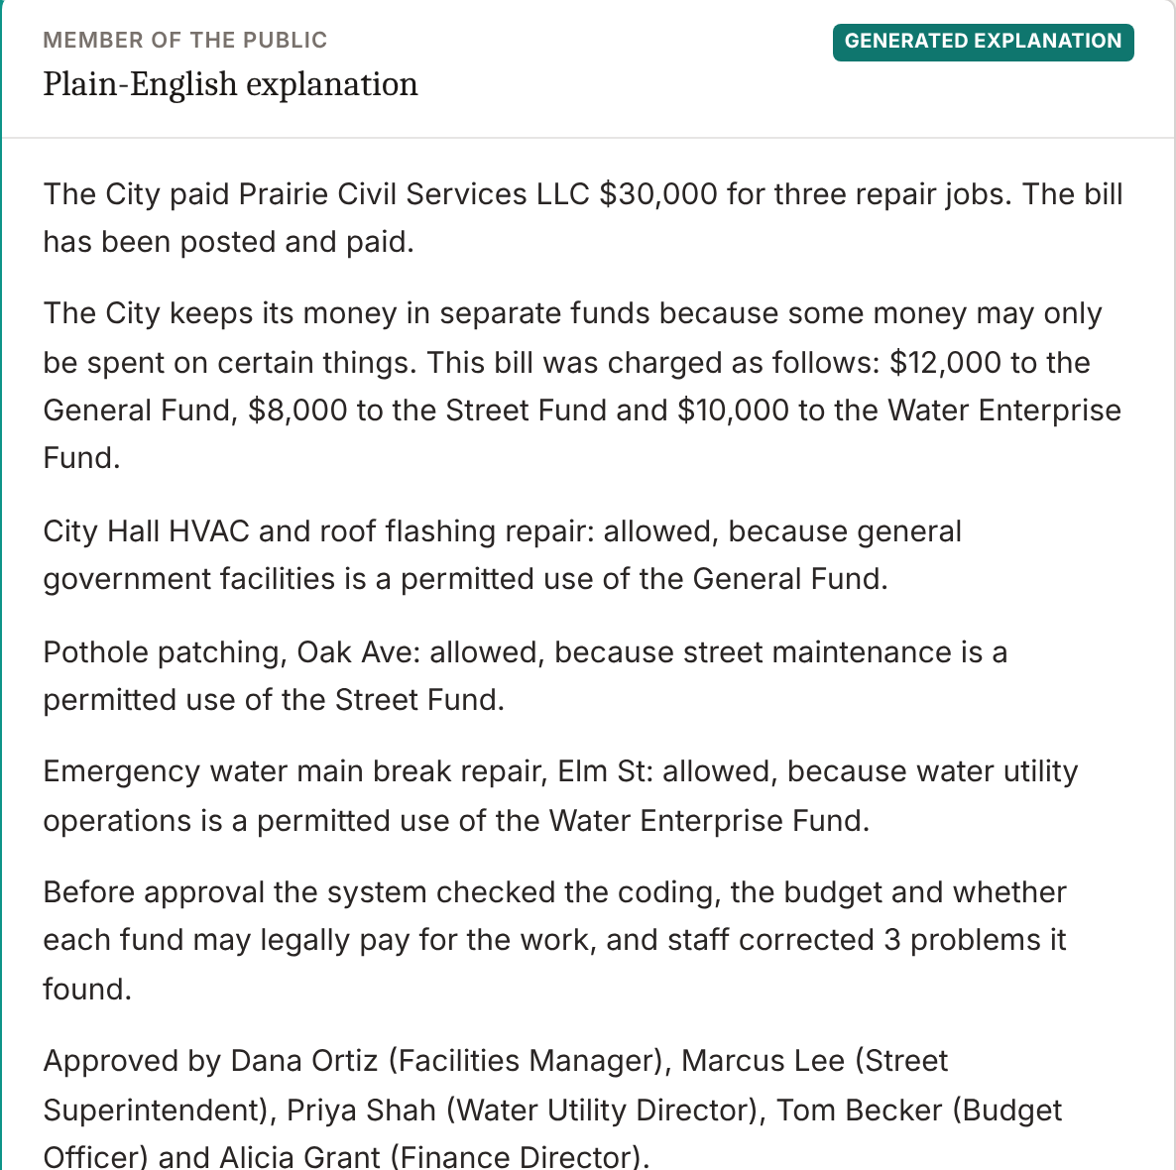
Rules decide, AI explains
EVALUATION PRINCIPLE · DETERMINISTIC VS GENERATIVE
Deterministic rules
Assistive and generative
COA, total, budget and purpose checks
Stop levels and required resolutions
Approval route, 10 posting and 4 payment gates
Journal entries, balanced per fund
Append-only event log
Suggests coding from vendor history; the clerk accepts or rejects
Explains the record for four audiences
Never sets amounts, waives a stop, approves or posts
Text is withheld if it names an amount, fund or person not in the record
Why it matters: finance and audit will trust AI only if it cannot change the books. Keeping explanation downstream of a deterministic record lets an LLM be added later without re-validating the controls. In this prototype the suggestions and explanations are template-based stand-ins.
Notes:
Rules are pure functions over configuration. AI only suggests coding and explains the record. In the prototype the explanation is template-generated; in production an LLM would write it and the same guardrail would block any text whose amounts, funds or people do not match.

Slide 12
Trade-offs and MVP
IMPORTANT TRADE-OFFS · MVP BOUNDARY
Decision | Why | Cost
Hard stop for restrictions, soft stop for budget | Matches how a city can lawfully fix each | Stop levels must be configured per check
Validate at entry, not at approval | Fixes happen while the clerk has context | Rules setup before go-live
Approval by affected department | Department heads see only what they own | More approvers on multi-fund invoices
Show per-fund entries to users | Teaches the model and matches audit tests | A denser screen for casual users
AI suggests and explains only | Trust from finance and audit | Less automation in release one
In the MVP
Not in the MVP
One invoice, multi-fund split
COA, budget and purpose rules from configuration
Stop levels with in-place resolution
Generated approval route
Per-fund GL and payment preview
Audience-specific explanation
PO match and encumbrance liquidation
Grant rules
Interfund transfers and loans
Year-end accruals
Real GL and bank integration
Bulk and OCR invoice intake
Notes:
Five decisions, each with what I gave up. The MVP is one multi-fund invoice done right end to end. PO matching, grants and integrations come later. The biggest open question is whether Springfield checks non-PO invoices at entry or relies on encumbrances.

Slide 13
Success measures and tests
SUCCESS MEASURES · TESTS WITH MUNICIPAL USERS
Success measures
Usability tests, one per role
First-pass validation rate
invoices with no exceptions
1
AP specialists
Can they fix a blocked line without help? Task time and errors.
Time to resolve an exception
flag to fix
2
Budget officers
Cycle time
receipt to payment-eligible
Is the transfer request enough to approve without a call?
Rework after submission
approvals cleared by a return or recall
3
Department heads
Fund misclassification findings
per audit
Does their approval view show what they need, and nothing else?
Manager comprehension
can explain a charge in one sentence
4
Auditors
Are the explanation and event log sufficient evidence?
Baselines come from the city's current AP data before any target is set.
Notes:
I have not invented target numbers; baselines come first. Manager comprehension is the measure most specific to this product. I would run one short usability session per role with this prototype.

Slide 14
Validate and build next
WHAT I WOULD VALIDATE OR BUILD NEXT
Questions for a government finance SME
Build next
Is the legal level of budgetary control fund plus department, or lower?
Does motor fuel tax cover contracted pothole repair?
What do bond covenants let water revenue pay for, including shared costs?
Do enterprise funds encumber, and should non-PO invoices be checked at entry?
Are the $25,000 capitalization and approval thresholds right?
Split-invoice detection. Flag invoices split to stay under an approval threshold.
Grant rules. Allowable cost and period checks on grant-funded lines.
Real LLM explanation. Behind the same guardrail that withholds mismatched text.
Delegation. Approver delegation with dates and a full audit trail.
Each answer changes a rule in configuration, so I would confirm these before building more.
Notes:
Before building more, I would confirm these assumptions with a finance SME, because each one changes a rule. Then: detect invoices split to dodge thresholds, add grant rules, put a real LLM behind the same guardrail, and add approver delegation.

